Slide 1

E4S: Extreme-Scale Scientific Software Stack https://e4s.io
Sameer Shende Performance Research Laboratory, OACISS, U. Oregon
sameer@cs.uoregon.edu
Tutorial, “Container Computing for HPC and Scientific Workloads”
Sunday, Nov. 17, 2019, 3:30 – 4:00 pm, Room # 207, Denver, CO.
https://sc19.supercomputing.org/presentation/?id=tut129&sess=sess206

Slide 2
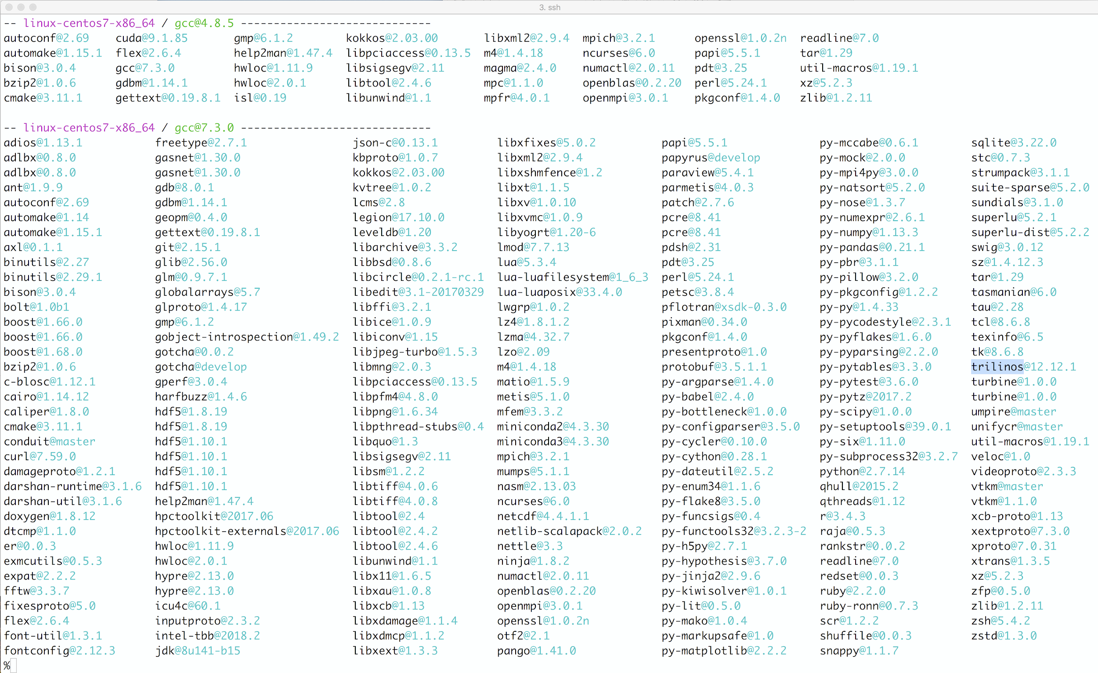
Extreme-scale Scientific Software Stack (E4S) https://e4s.io
E4S is a community effort to provide open source software packages for developing, deploying, and running scientific applications on HPC platforms.
E4S provides both source builds and containers of a broad collection of HPC software packages.
E4S exists to accelerate the development, deployment and use of HPC software, lowering the barriers for HPC users.
E4S provides containers and turn-key, from-source builds of 80+ popular HPC software packages:
MPI: MPICH and OpenMPI
Development tools: TAU, HPCToolkit, and PAPI
Math libraries: PETSc and Trilinos
Data and Viz tools: Adios, HDF5, and Paraview

Slide 3
Extreme-scale Scientific Software Stack (E4S) https://e4s.io
Spack [http://spack.io] is the primary means for software delivery
SDKs: collection of related ECP ST products where coordination across package teams will improve usability and practicies, and foster community growth among teams that develop similar and complimentary capabilities. An SDK involves several products.
Containers of pre-built binaries of ECP ST products.
Container runtimes supported
Docker: Dockerhub: exascaleproject/sdk:AHM19
Charliecloud
Shifter
Singularity
Inception at NCAR
VirtualBox Open Virtualization Appliance (OVA) image that contains these runtimes
MPI replacement strategies to use native network interconnect

Slide 4
Spack
E4S uses the Spack package manager for software delivery
Spack provides the ability to specify versions of software packages that are and are not interoperable.
Spack is a build layer for not only E4S software, but also a large collection of software tools and libraries outside of ECP ST.
Spack supports achieving and maintaining interoperability between ST software packages.
Acknowledgement: The remaining Spack slides in this presentation are from a talk given by the Spack PI, Todd Gamblin, CASC, LLNL.
Next: Motivation for Spack!

Slide 5
Scientific software is becoming extremely complex
Nalu: Generalized Unstructured Massively Parallel Low Mach Flow
dealii: C++ Finite Element Library
R Miner: R Data Mining Library

Slide 6
Even proprietary codes are based on many open source libraries
Half of this DAG is external (blue); more than half of it is open source
Nearly all of it needs to be built specially for HPC to get the best performance

Slide 7
The Exascale Computing Project is building an entire ecosystem
15+ applications
80+ software packages
5+ target architectures/platforms Xeon Power KNL NVIDIA ARM Laptops?
x
x
Up to 7 compilers Intel GCC Clang XL PGI Cray NAG
10+ Programming Models OpenMPI MPICH MVAPICH OpenMP CUDA OpenACC Dharma Legion RAJA Kokkos
2-3 versions of each package + external dependencies
x
x
x
= up to 1,260,000 combinations!
Every application has its own stack of dependencies.
Developers, users, and facilities dedicate (many) FTEs to building & porting.
Often trade reuse and usability for performance.
We must make it easier to rely on others’ software!

Slide 8
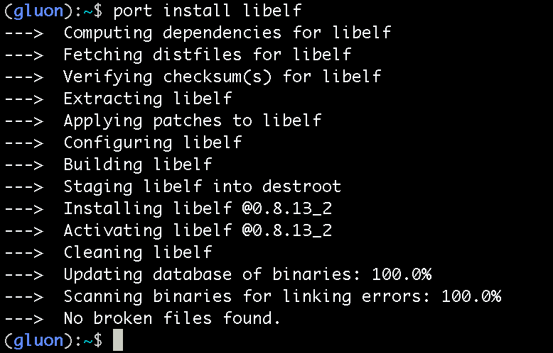
How to install software on a Mac laptop, circa 2013

Slide 9
How to install software on a supercomputer
Download all 16 tarballs you need
Start building!
configure
cmake
make install
Fight with compiler...
Tweak configure args...
make
make
configure
configure
make install
make install
make
make
Run code
Segfault!?
Start over…
make

Slide 10
What about modules?
Most supercomputers deploy some form of environment modules
TCL modules (dates back to 1995) and Lmod (from TACC) are the most popular
Modules don’t handle installation!
They only modify your environment (things like PATH, LD_LIBRARY_PATH, etc.)
Someone (likely a team of people) has already installed gcc for you!
Also, you can only `module load` the things they’ve installed
$ gcc
bash: gcc: command not found
$ module load gcc/7.0.1
$ gcc –dumpversion
7.0.1

Slide 11




What about containers?
Containers provide a great way to reproduce and distribute an already-built software stack
Someone needs to build the container!
This isn’t trivial
Containerized applications still have hundreds of dependencies
Using the OS package manager inside a container is insufficient
Most binaries are built unoptimized
Generic binaries, not optimized for specific architectures
Developing with an OS software stack can be painful
Little freedom to choose versions
Little freedom to choose compiler options, build options, etc. for packages
We need something more flexible to build the containers

Slide 12

Spack is a flexible package manager for HPC
How to install Spack (works out of the box):
How to install a package:
HDF5 and its dependencies are installed within the Spack directory.
Unlike typical package managers, Spack can also install many variants of the same build.
Different compilers
Different MPI implementations
Different build options
$ git clone https://github.com/spack/spack
$ . spack/share/spack/setup-env.sh
$ spack install hdf5
Visit spack.io
github.com/spack/spack
@spackpm

Slide 13
Spack provides the spec syntax to describe custom configurations
$ spack install mpileaks unconstrained
$ spack install mpileaks@3.3 @ custom version
$ spack install mpileaks@3.3 %gcc@4.7.3 % custom compiler
$ spack install mpileaks@3.3 %gcc@4.7.3 +threads +/- build option
$ spack install mpileaks@3.3 cxxflags="-O3 –g3” setting compiler flags
$ spack install mpileaks@3.3 os=cnl10 target=haswell setting target for X-compile
$ spack install mpileaks@3.3 ^mpich@3.2 %gcc@4.9.3 ^ dependency information
Each expression is a spec for a particular configuration
Each clause adds a constraint to the spec
Constraints are optional – specify only what you need.
Customize install on the command line!
Spec syntax is recursive
Full control over the combinatorial build space

Slide 14
`spack list` shows what packages are available
$ spack list
==> 3041 packages.
abinit glew nalu py-fastaindex r-cairo r-viridislite
abyss glfmultiples nalu-wind py-fasteners r-callr r-visnetwork
accfft glib namd py-faststructure r-car r-vsn
ack glibmm nano py-filelock r-caret r-webshot
activeharmony glimmer nanoflann py-fiona r-category r-whisker
adept-utils glm nanopb py-fiscalyear r-catools r-withr
adios global nasm py-flake8 r-cdcfluview r-xde
adios2 globalarrays nauty py-flake8-polyfill r-cellranger r-xgboost
adlbx globus-toolkit ncbi-magicblast py-flask r-checkmate r-xlconnect
adol-c glog ncbi-rmblastn py-flask-compress r-checkpoint r-xlconnectjars
aegean gloo ncbi-toolkit py-flask-socketio r-chemometrics r-xlsx
aida glpk nccl py-flexx r-chron r-xlsxjars
albany glproto nccmp py-fn r-circlize r-xmapbridge
albert glvis ncdu py-fparser r-class r-xml
alglib gmake ncftp py-funcsigs r-classint r-xml2
allinea-forge gmap-gsnap ncl py-functools32 r-cli r-xnomial
allinea-reports gmime nco py-future r-clipr r-xtable
allpaths-lg gmodel ncurses py-futures r-cluster r-xts
alquimia gmp ncview py-fypp r-clustergeneration r-xvector
alsa-lib gmsh ndiff py-gdbgui r-clusterprofiler r-yaml
aluminum gmt nek5000 py-genders r-cner r-yapsa
amg gnat nekbone py-genshi r-coda r-yaqcaffy
amg2013 gnu-prolog nekcem py-geopandas r-codetools r-yarn
amp gnupg nektar py-gevent r-coin r-zlibbioc
ampliconnoise gnuplot neovim py-git-review r-colorspace r-zoo
amrex gnutls nest py-git2 r-combinat r3d
amrvis go netcdf py-gnuplot r-complexheatmap racon
andi go-bootstrap netcdf-cxx py-goatools r-compositions raft
angsd gobject-introspection netcdf-cxx4 py-gpaw r-convevol ragel
ant googletest netcdf-fortran py-greenlet r-corhmm raja
antlr gotcha netgauge py-griddataformats r-corpcor randfold
ants gource netgen py-guidata r-corrplot random123
ape gperf netlib-lapack py-guiqwt r-covr randrproto
. . .
Spack has over 3,000 builtin package recipes.

Slide 15
`spack find` shows what is installed
$ spack find
==> 103 installed packages.
-- linux-rhel7-x86_64 / gcc@4.4.7 --------------------------------
ImageMagick@6.8.9-10 glib@2.42.1 libtiff@4.0.3 pango@1.36.8 qt@4.8.6
SAMRAI@3.9.1 graphlib@2.0.0 libtool@2.4.2 parmetis@4.0.3 qt@5.4.0
adept-utils@1.0 gtkplus@2.24.25 libxcb@1.11 pixman@0.32.6 ravel@1.0.0
atk@2.14.0 harfbuzz@0.9.37 libxml2@2.9.2 py-dateutil@2.4.0 readline@6.3
boost@1.55.0 hdf5@1.8.13 llvm@3.0 py-ipython@2.3.1 scotch@6.0.3
cairo@1.14.0 icu@54.1 metis@5.1.0 py-nose@1.3.4 starpu@1.1.4
callpath@1.0.2 jpeg@9a mpich@3.0.4 py-numpy@1.9.1 stat@2.1.0
dyninst@8.1.2 libdwarf@20130729 ncurses@5.9 py-pytz@2014.10 xz@5.2.0
dyninst@8.1.2 libelf@0.8.13 ocr@2015-02-16 py-setuptools@11.3.1 zlib@1.2.8
fontconfig@2.11.1 libffi@3.1 openssl@1.0.1h py-six@1.9.0
freetype@2.5.3 libmng@2.0.2 otf@1.12.5salmon python@2.7.8
gdk-pixbuf@2.31.2 libpng@1.6.16 otf2@1.4 qhull@1.0
-- linux-rhel7-x86_64 / gcc@4.8.2 --------------------------------
adept-utils@1.0.1 boost@1.55.0 cmake@5.6-special libdwarf@20130729 mpich@3.0.4
adept-utils@1.0.1 cmake@5.6 dyninst@8.1.2 libelf@0.8.13 openmpi@1.8.2
-- linux-rhel7-x86_64 / intel@14.0.2 -----------------------------
hwloc@1.9 mpich@3.0.4 starpu@1.1.4
-- linux-rhel7-x86_64 / intel@15.0.0 -----------------------------
adept-utils@1.0.1 boost@1.55.0 libdwarf@20130729 libelf@0.8.13 mpich@3.0.4
-- linux-rhel7-x86_64 / intel@15.0.1 -----------------------------
adept-utils@1.0.1 callpath@1.0.2 libdwarf@20130729 mpich@3.0.4
boost@1.55.0 hwloc@1.9 libelf@0.8.13 starpu@1.1.4
All the versions coexist!
Multiple versions of same package are ok.
Packages are installed to automatically find correct dependencies.
Binaries work regardless of user’s environment.
Spack also generates module files.
Don’t have to use them.

Slide 16
The Spack community is growing rapidly
Spack simplifies HPC software for:
Users
Developers
Cluster installations
The largest HPC facilities
Spack is central to ECP’s software strategy
Enable software reuse for developers and users
Allow the facilities to consume the entire ECP stack
The roadmap is packed with new features:
Building the ECP software distribution
Better workflows for building containers
Stacks for facilities
Chains for rapid dev workflow
Optimized binaries
Better dependency resolution
Visit spack.io
github.com/spack/spack
@spackpm

Slide 17

Exascale Platform Preparation
SDK Exascale platform preparation is focused on interoperable delivery.
ST products from SDKs are released in the Extreme-scale Scientific Software Stack (E4S) [https://e4s.io].
E4S: a community effort to provide open source software packages for developing, deploying, and running scientific applications on HPC platforms
E4S containers and Spack based builds currently support the following pre-exascale systems:
Theta at ALCF (Cray XC).
Cori at NERSC (Cray XC).
Summit, Sierra, Butte, RZAnsel (IBM Power 9 AC922).
Linux x86_64 systems at LANL (Grizzly), Sandia (Voltrino), LLNL (Quartz).
Other NSF platforms including Frontera (TACC).
E4S preparation for future Exascale systems includes testing on AMD and Intel systems.
**E4S is led and funded out of the PMR SDK, but is the delivery vehicle for all SDK efforts

Slide 18
Integration and Interoperability: E4S
E4S is released twice a year. Two versions have been released to date and we are planning for a release at SC19. The E4S 0.2 release supports:
Containers and turn-key, from-source builds of 80+ popular HPC software packages
37 full release ECP ST products including:
MPI: MPICH and OpenMPI
Development tools: TAU, HPCToolkit, and PAPI
Math libraries: PETSc and Trilinos
Data and Viztools: Adios, HDF5, and Paraview
Limited access to 10 additional ECP ST products
Docker
Singularity
Shifter
Charliecloud
Inception
Open Virtualization Appliance (OVA) for VirtualBox features Spack, E4S containers, and support for container environments

Slide 19

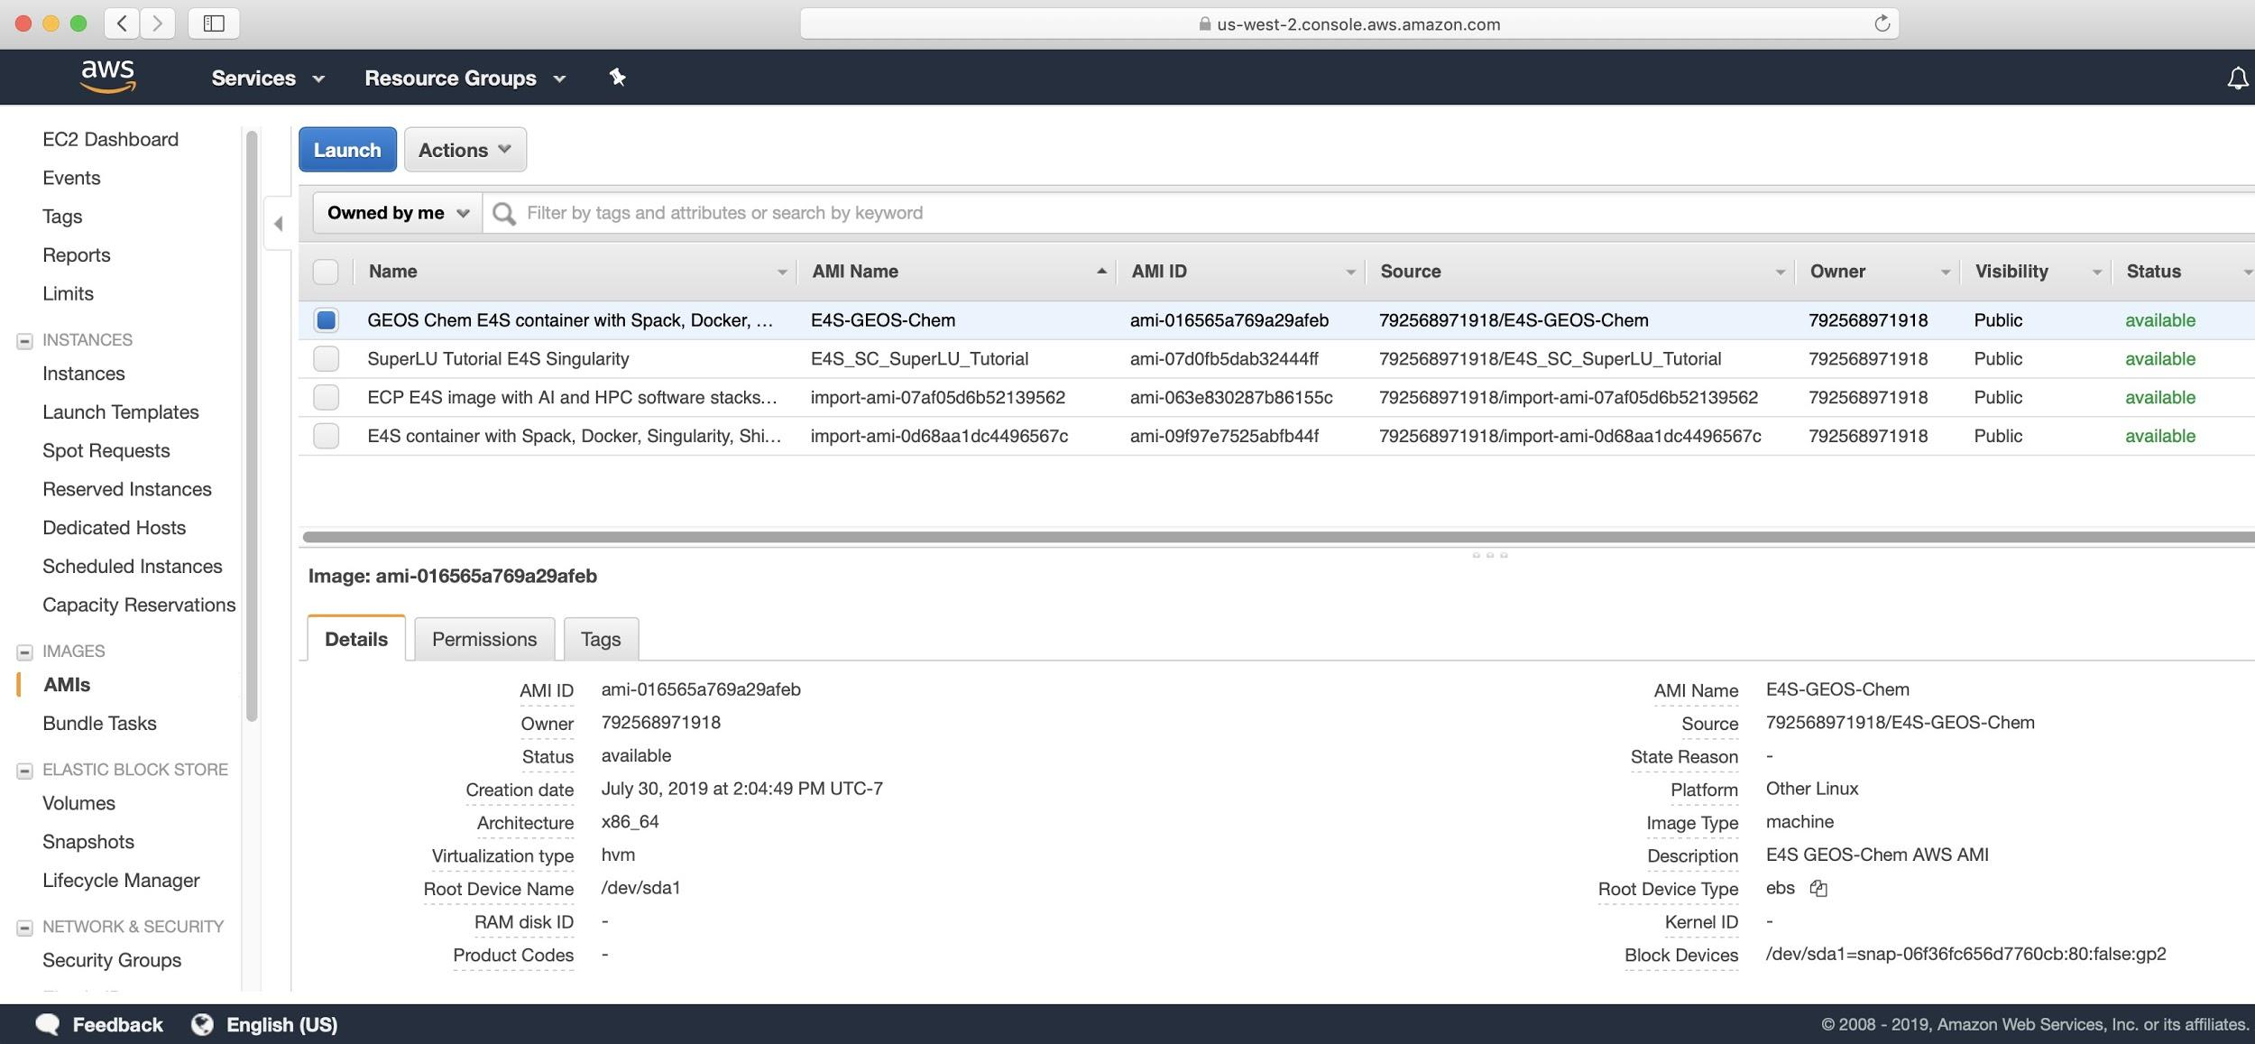
Integration and Interoperability: E4S on AWS
E4S AWS public image ami-063e830287b86155c (US-West-2 Oregon) has following container runtimes:
Docker
Shifter
Singularity
Charliecloud
Spack with base PMR components
E4S full featured Singularity image
(exascaleproject/sdk:AHM19)
Used in ISC-HPC 2019 tutorials
Used as base image for NASA GEOS-Chem E4S public image
Resources provided by AWS AI/ML team

Slide 20
Reproducible, Customizable Container Builds & Spack Mirrors
E4S provides base images and recipes for building Docker containers based on SDKs
Git: https://github.com/UO-OACISS/e4s
Base images released (September 2019):
UBI 7.6 (RHEL Universal Binary Image for container builds) for x86_64
Centos 7.6 for x86_64
Ubuntu 18.04 for x86_64
UBI 7.6 (RHEL) for ppc64le
E4S provides build caches for Spack for native bare-metal as well as container builds based installation of ST products
Build caches: https://oaciss.uoregon.edu/e4s
The build cache model can be extended to target platforms, and can be managed by facilities staff when appropriate.

Slide 21
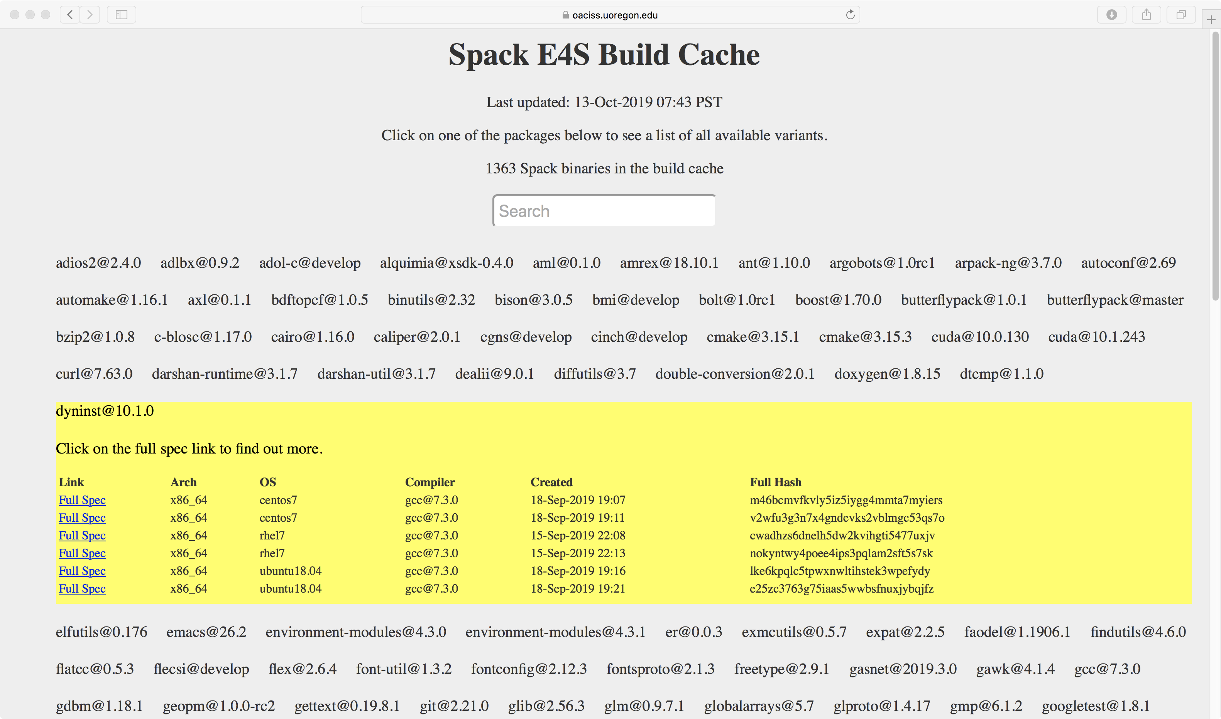
E4S Build Cache Binaries
https://oaciss.uoregon.edu/e4s

Slide 22
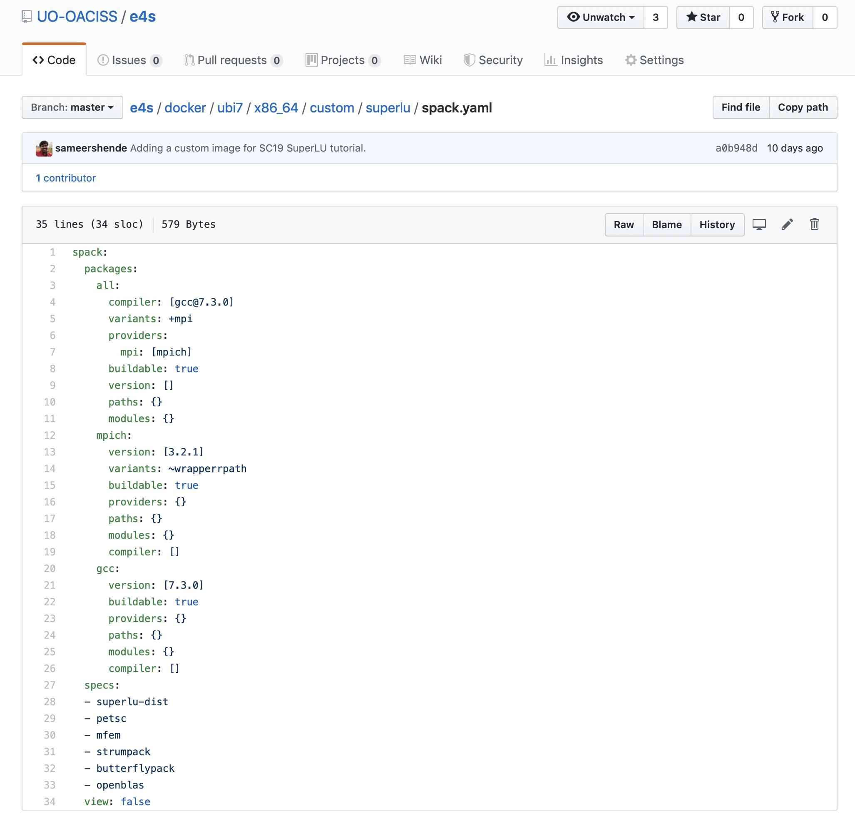
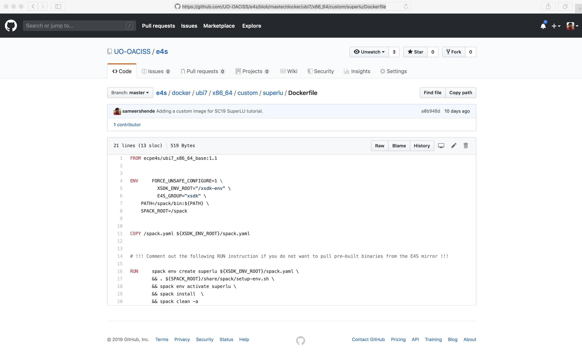
Reproducible Container Builds using E4S Base Images
PMR SDK base image (UBI 7.6) has Spack build cache mirror and GPG key installed.
Base image has GCC and MPICH configured for MPICH ABI level replacement (with system MPI).
Customized container build using binaries from E4S Spack build cache for fast deployment.
No need to rebuild packages from the source code.
Same recipe for container and native bare-metal builds with Spack!

Slide 23
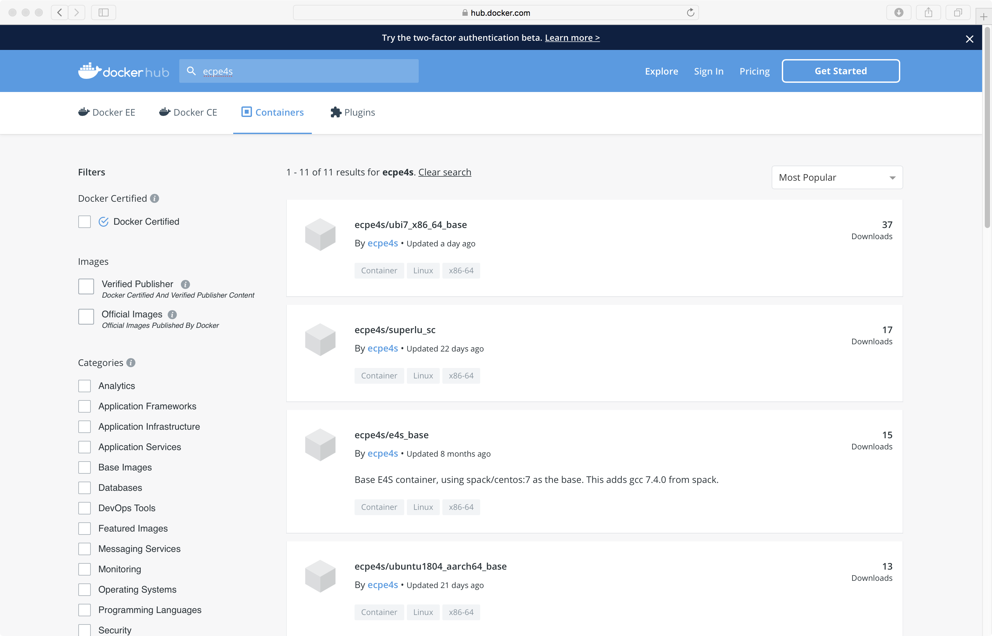
Reproducible Base Images on Dockerhub
ecpe4s
x86_64
ppc64le
aarch64
Centos 7.6
Ubuntu 18.04
RHEL/UBI 7.6

Slide 24
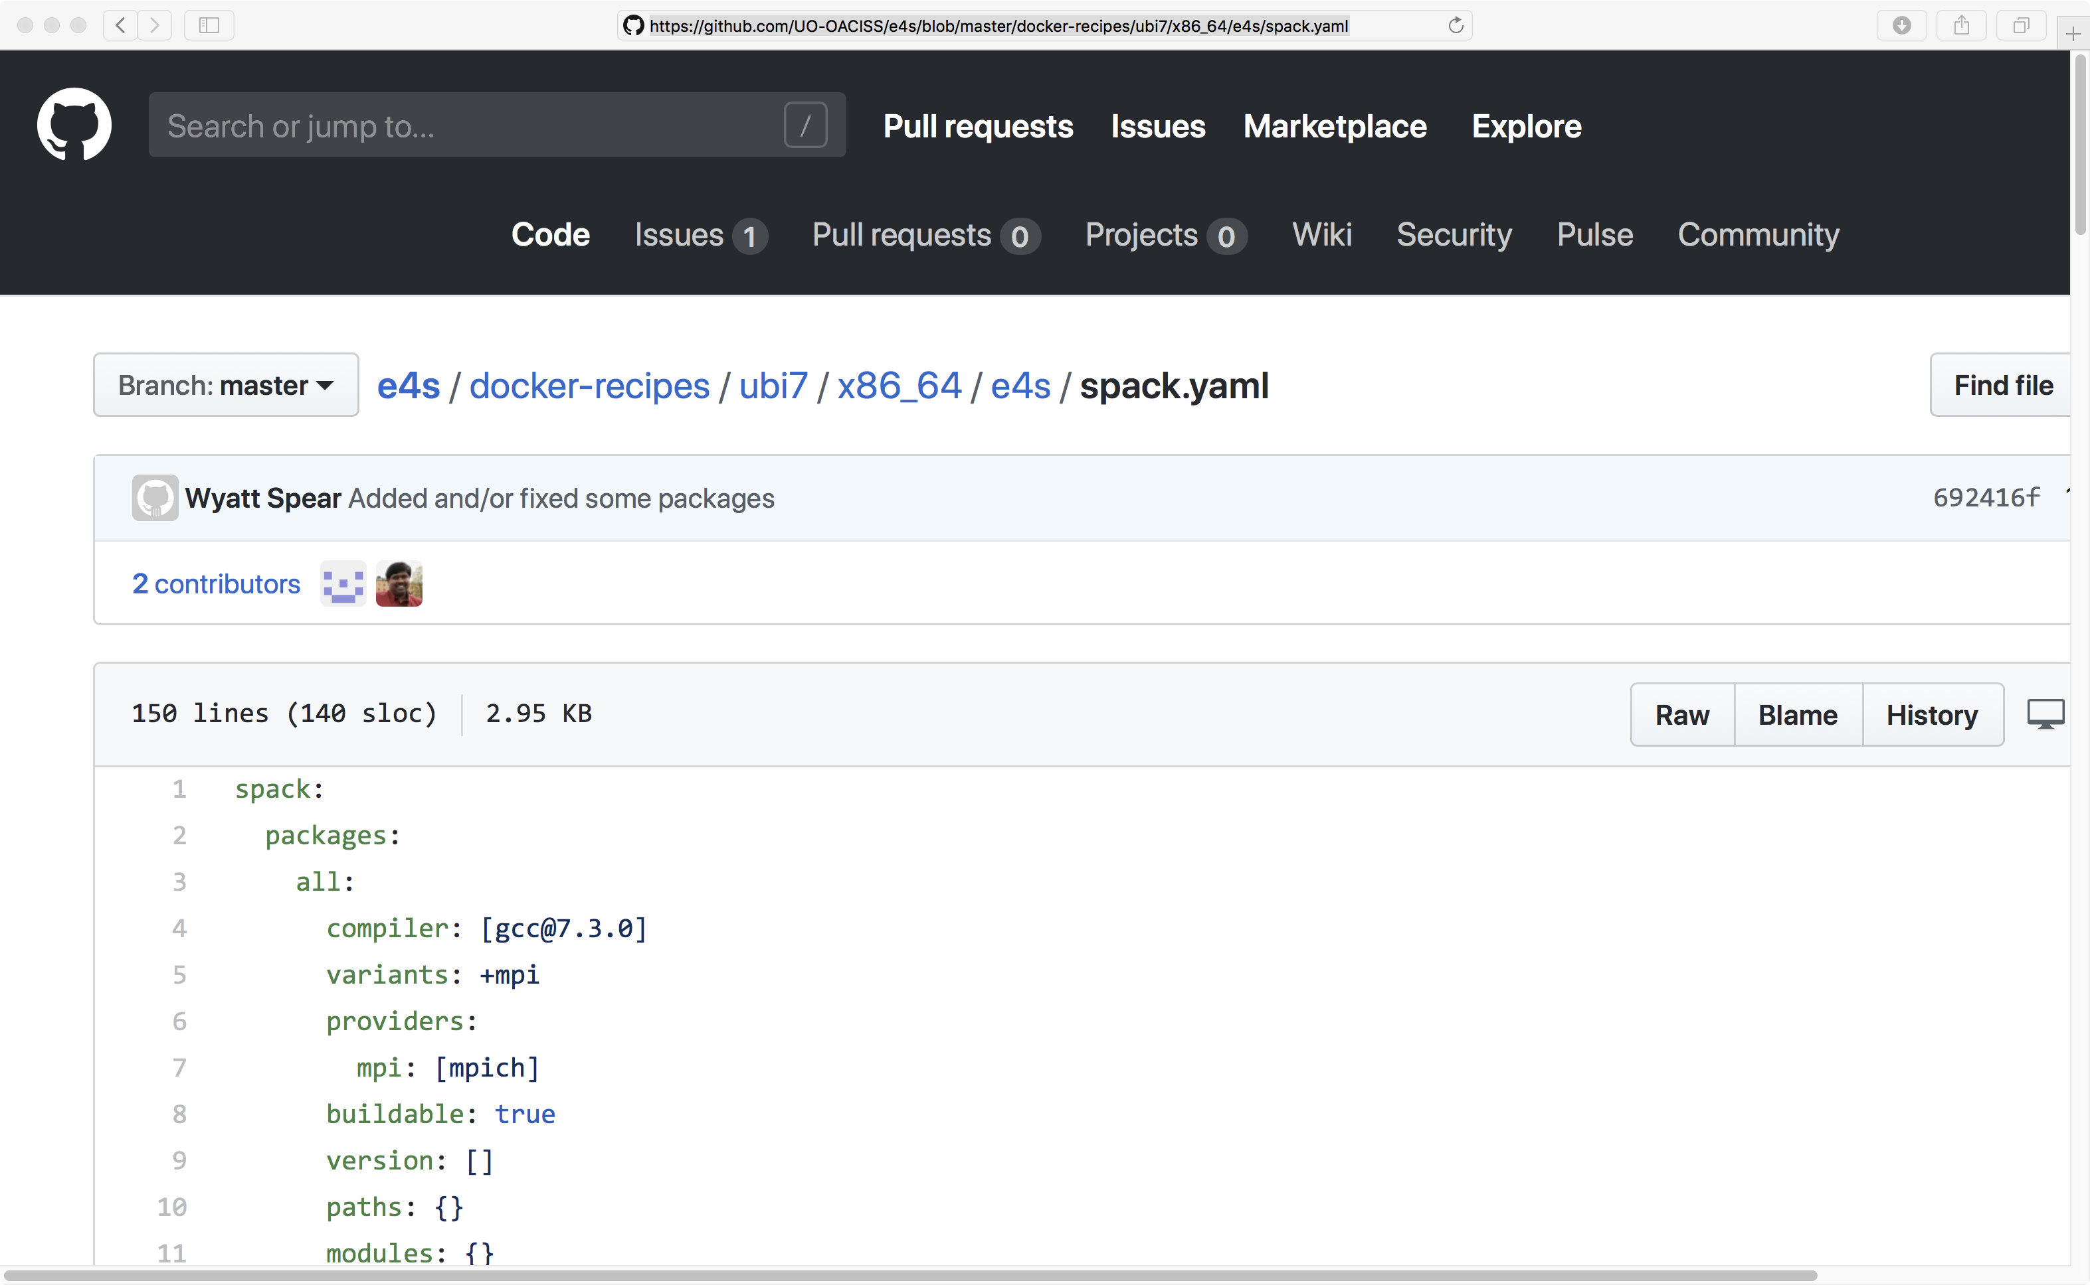
Docker Recipes on GitHub
Base images
SDKs
E4S
https://github.com/UO-OACISS/e4s

Slide 25
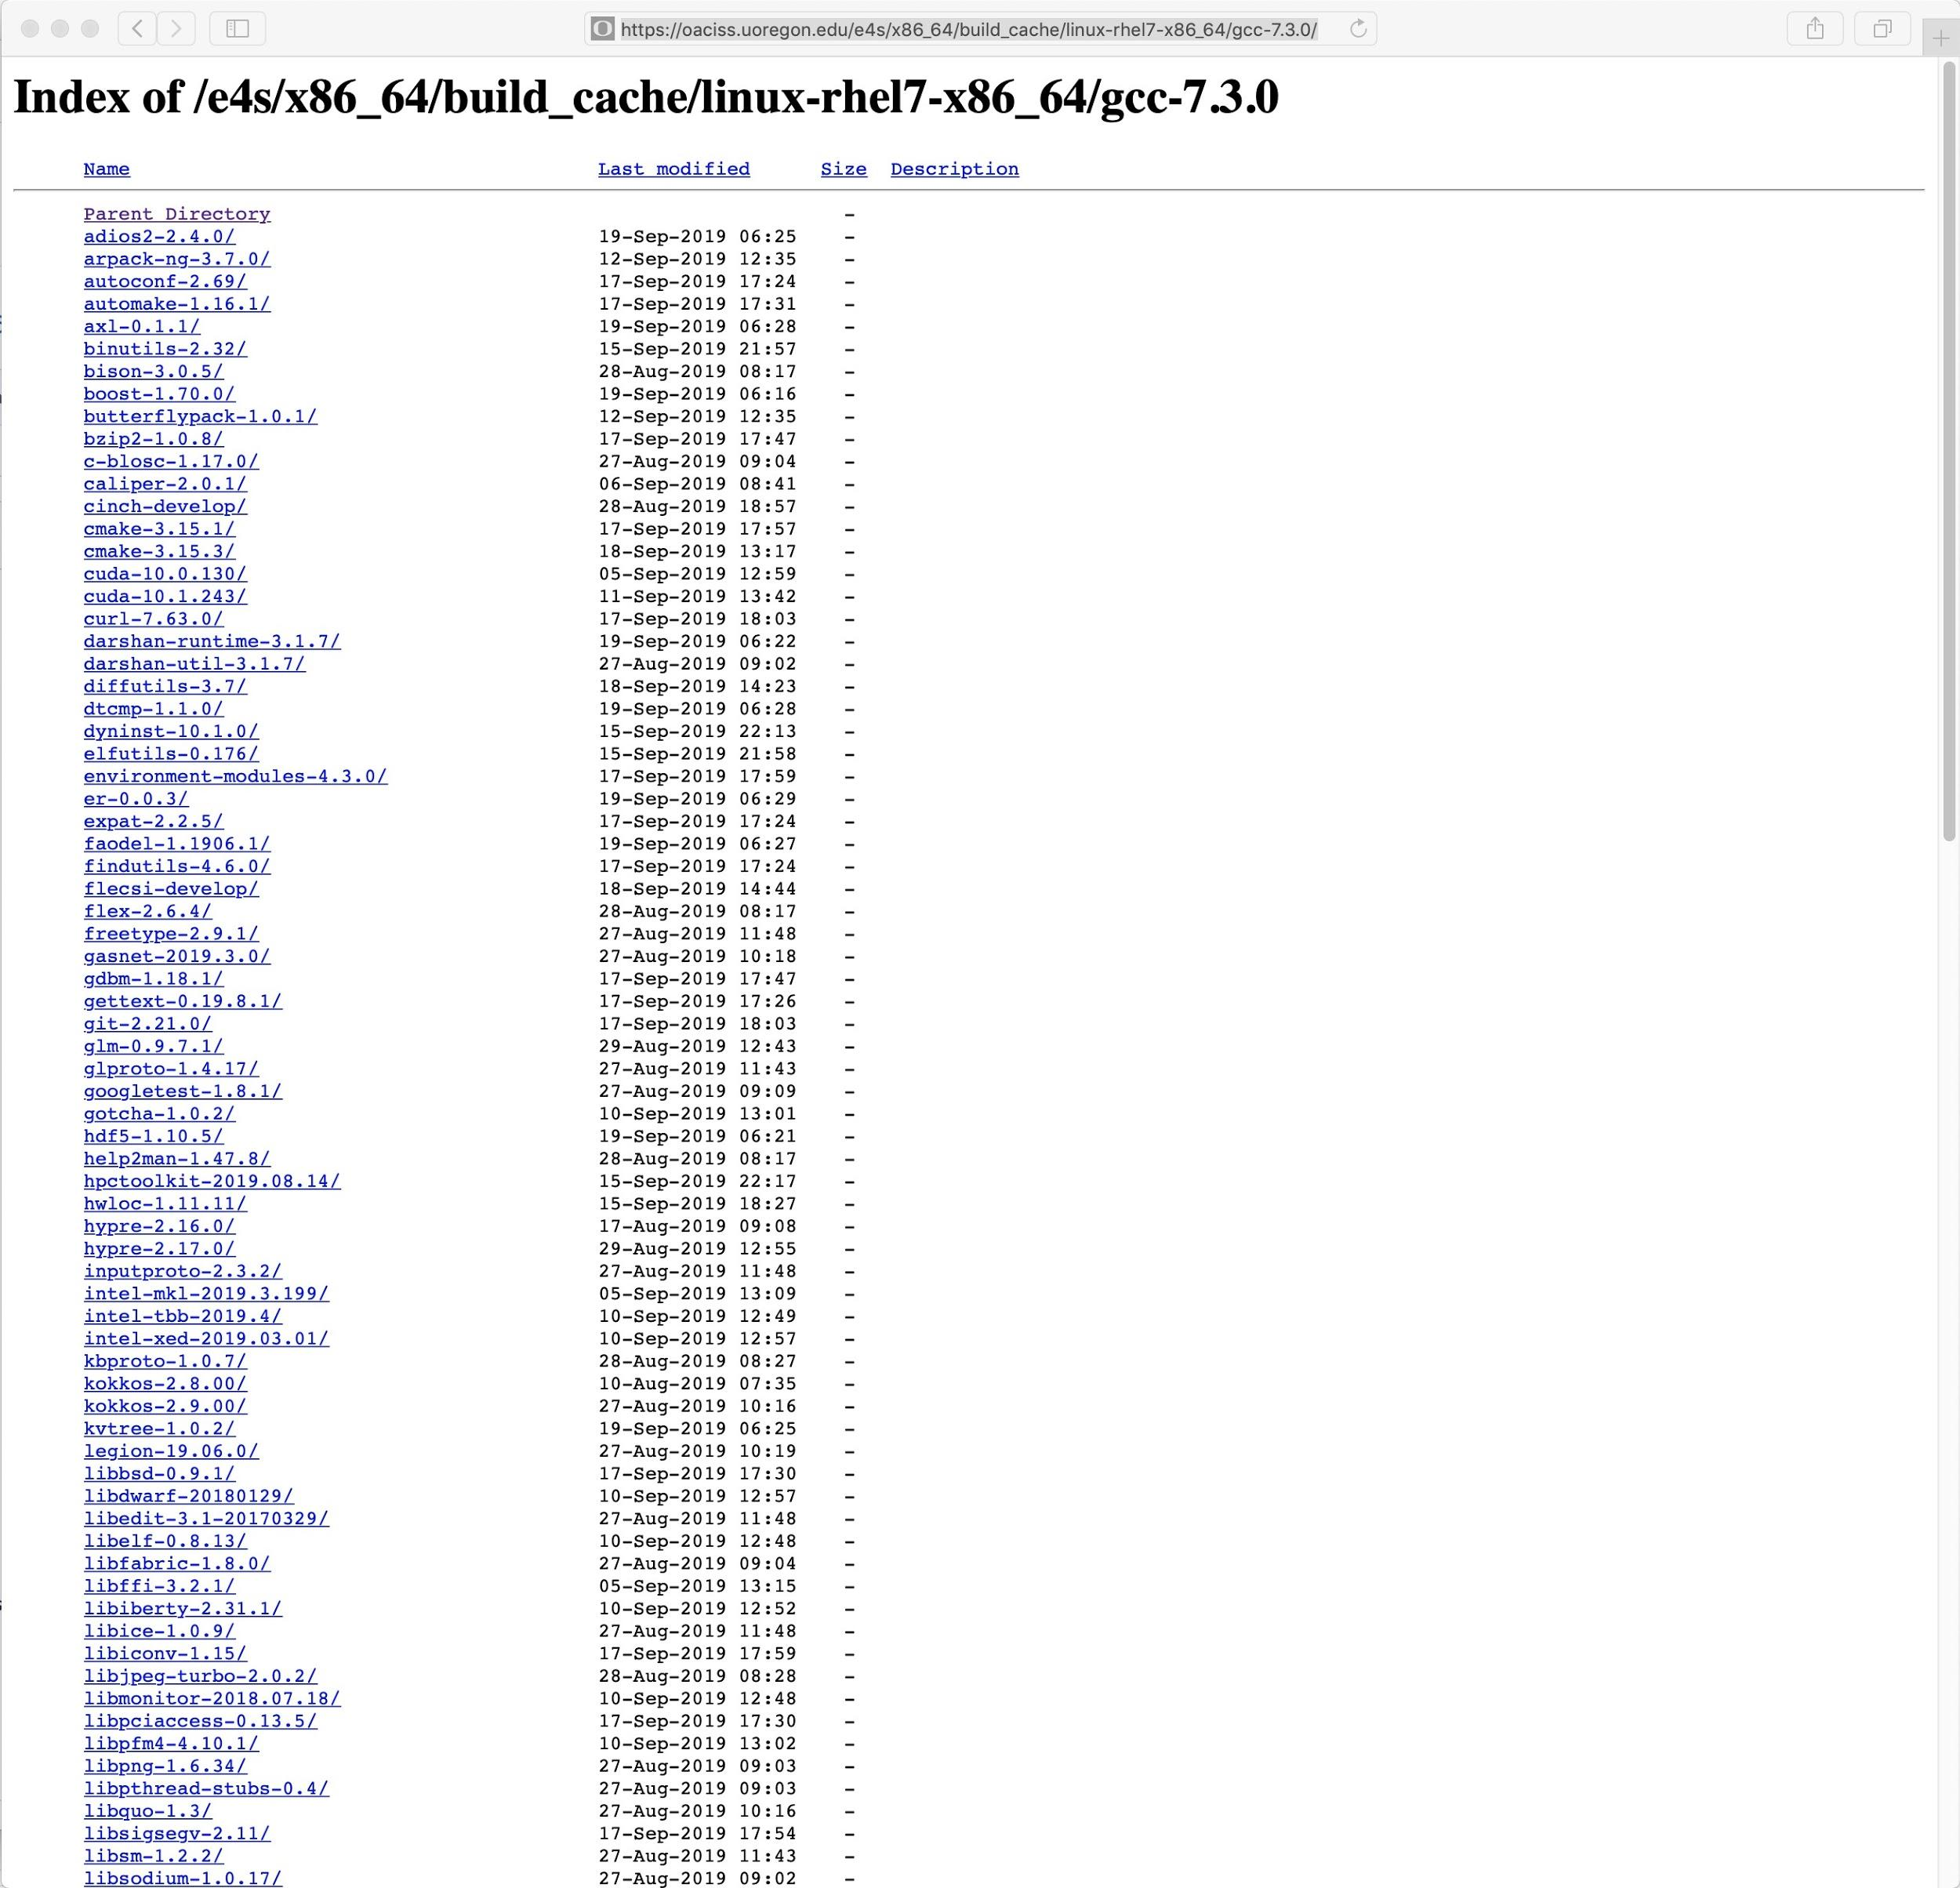
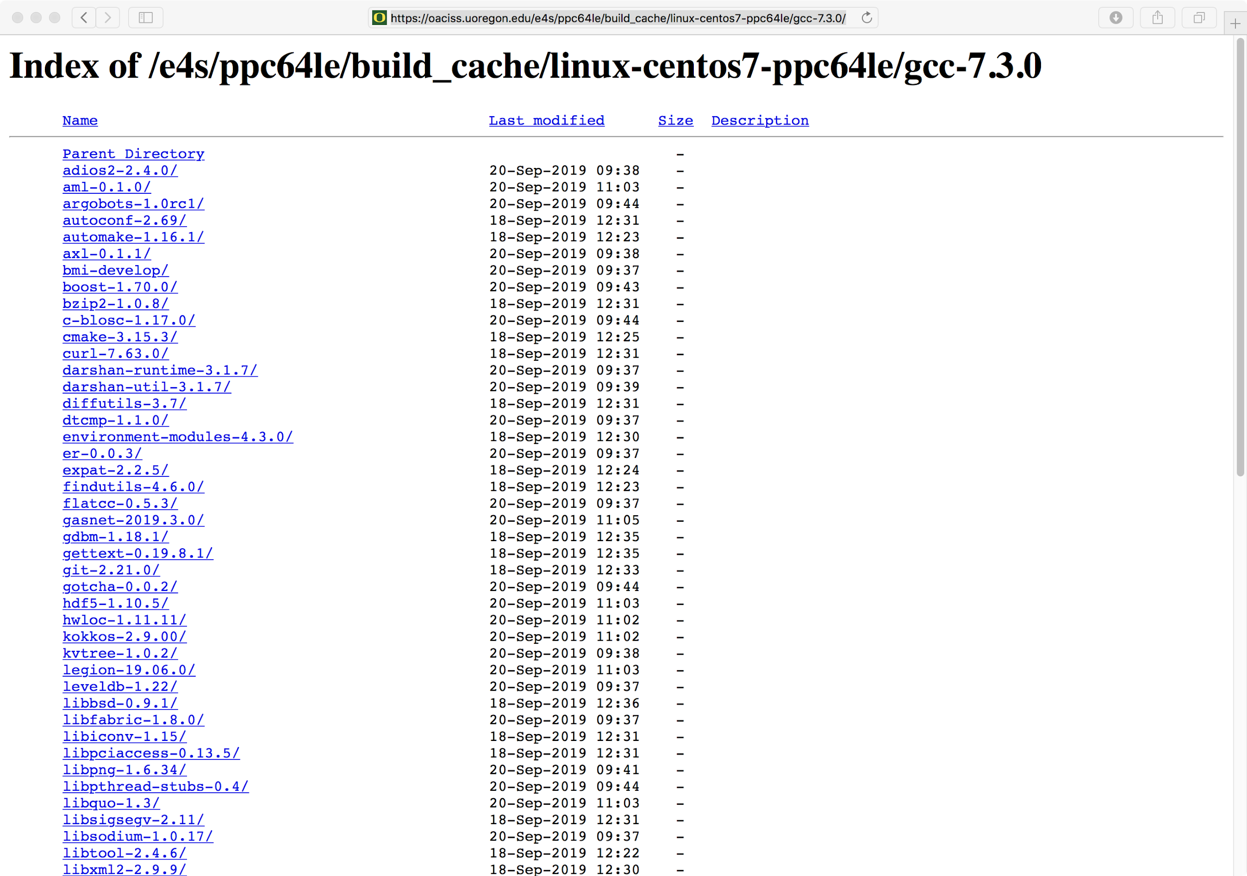
Spack Build Caches from E4S Base Images
IBM Power 9 (ppc64le) build cache
2.6 GB on disk
early stages of effort
Initial ARM 64 build cache is underway
x86_64 build cache
40 GB on disk

Slide 26
Docker container of E4S
% docker pull exascaleproject/e4s_x86_64:1.0
Using USB stick or images from https://e4s.io:
% unxz –c e4s_x86_64.xz | docker load % docker images
Mount home directory:
% docker –i –v $HOME:$HOME –t exascaleproject/e4s_x86_64:1.0 /bin/bash
% which spack
% cp –r /usr/local/packages/ecp/demo . ; cd demo; cat README

Slide 27
Using Shifter at NCSA BlueWaters
Load shifter module and E4S image on the compute node
Allocate a node
% qsub -I -l nodes=1:ppn=32 -l walltime=01:15:00 -l gres=shifter16
Load the shifter module
% module load shifter
Pull the image (once)
% shifterimg pull exascaleproject/sdk:AHM19
Launch the image
% shifter --image=exascaleproject/sdk:AHM19 -- /bin/bash
% unset CRAYPE_VERSION; . /etc/bashrc
% spack find

Slide 28
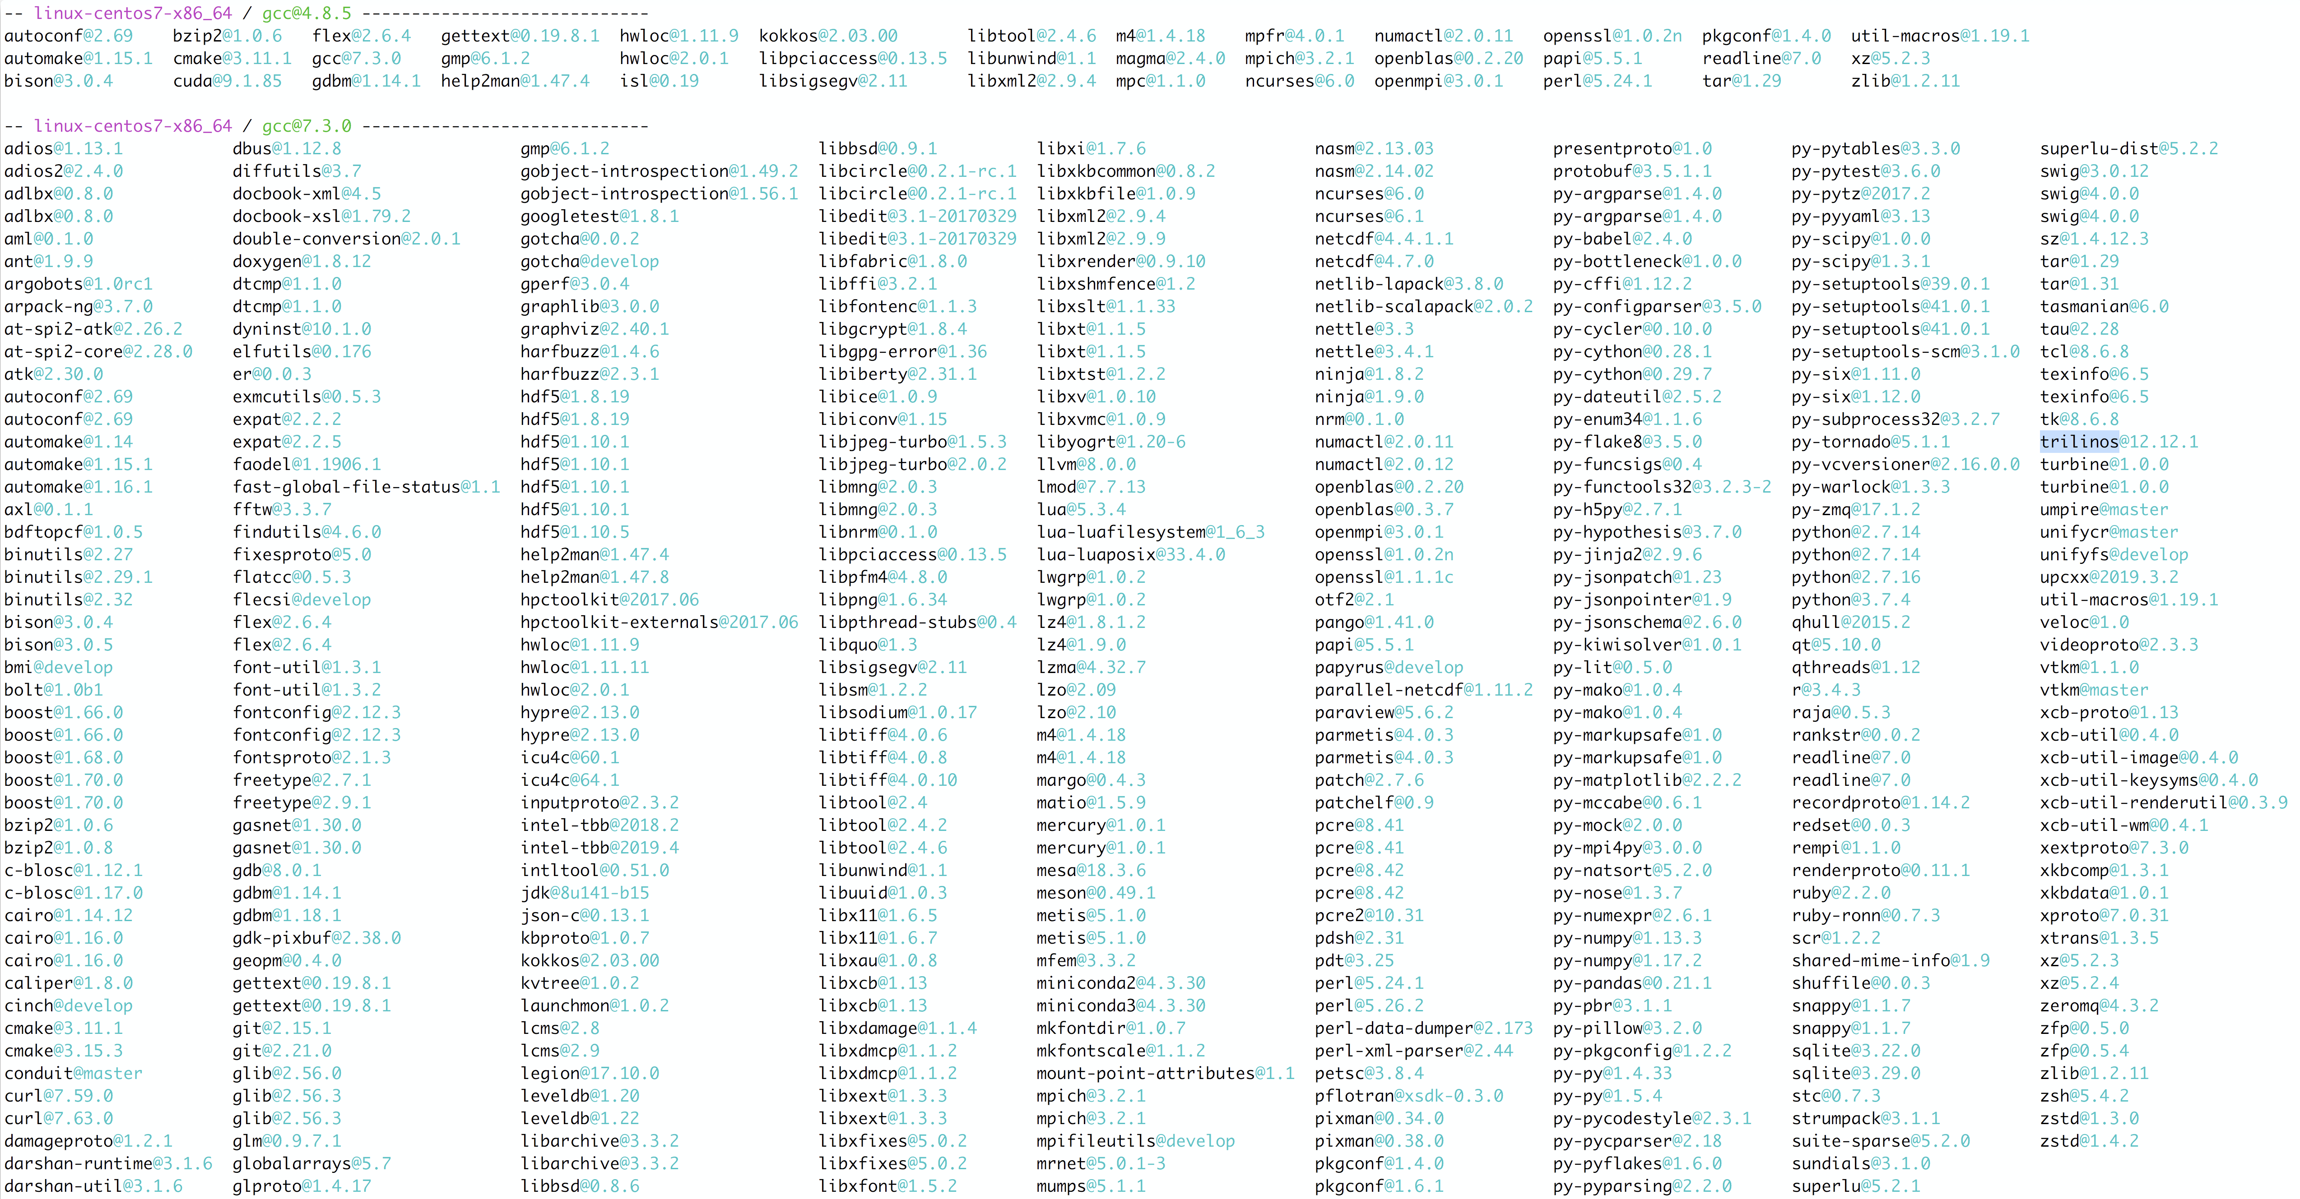
Extreme-scale Scientific Software Stack (E4S) https://e4s.io

Slide 29
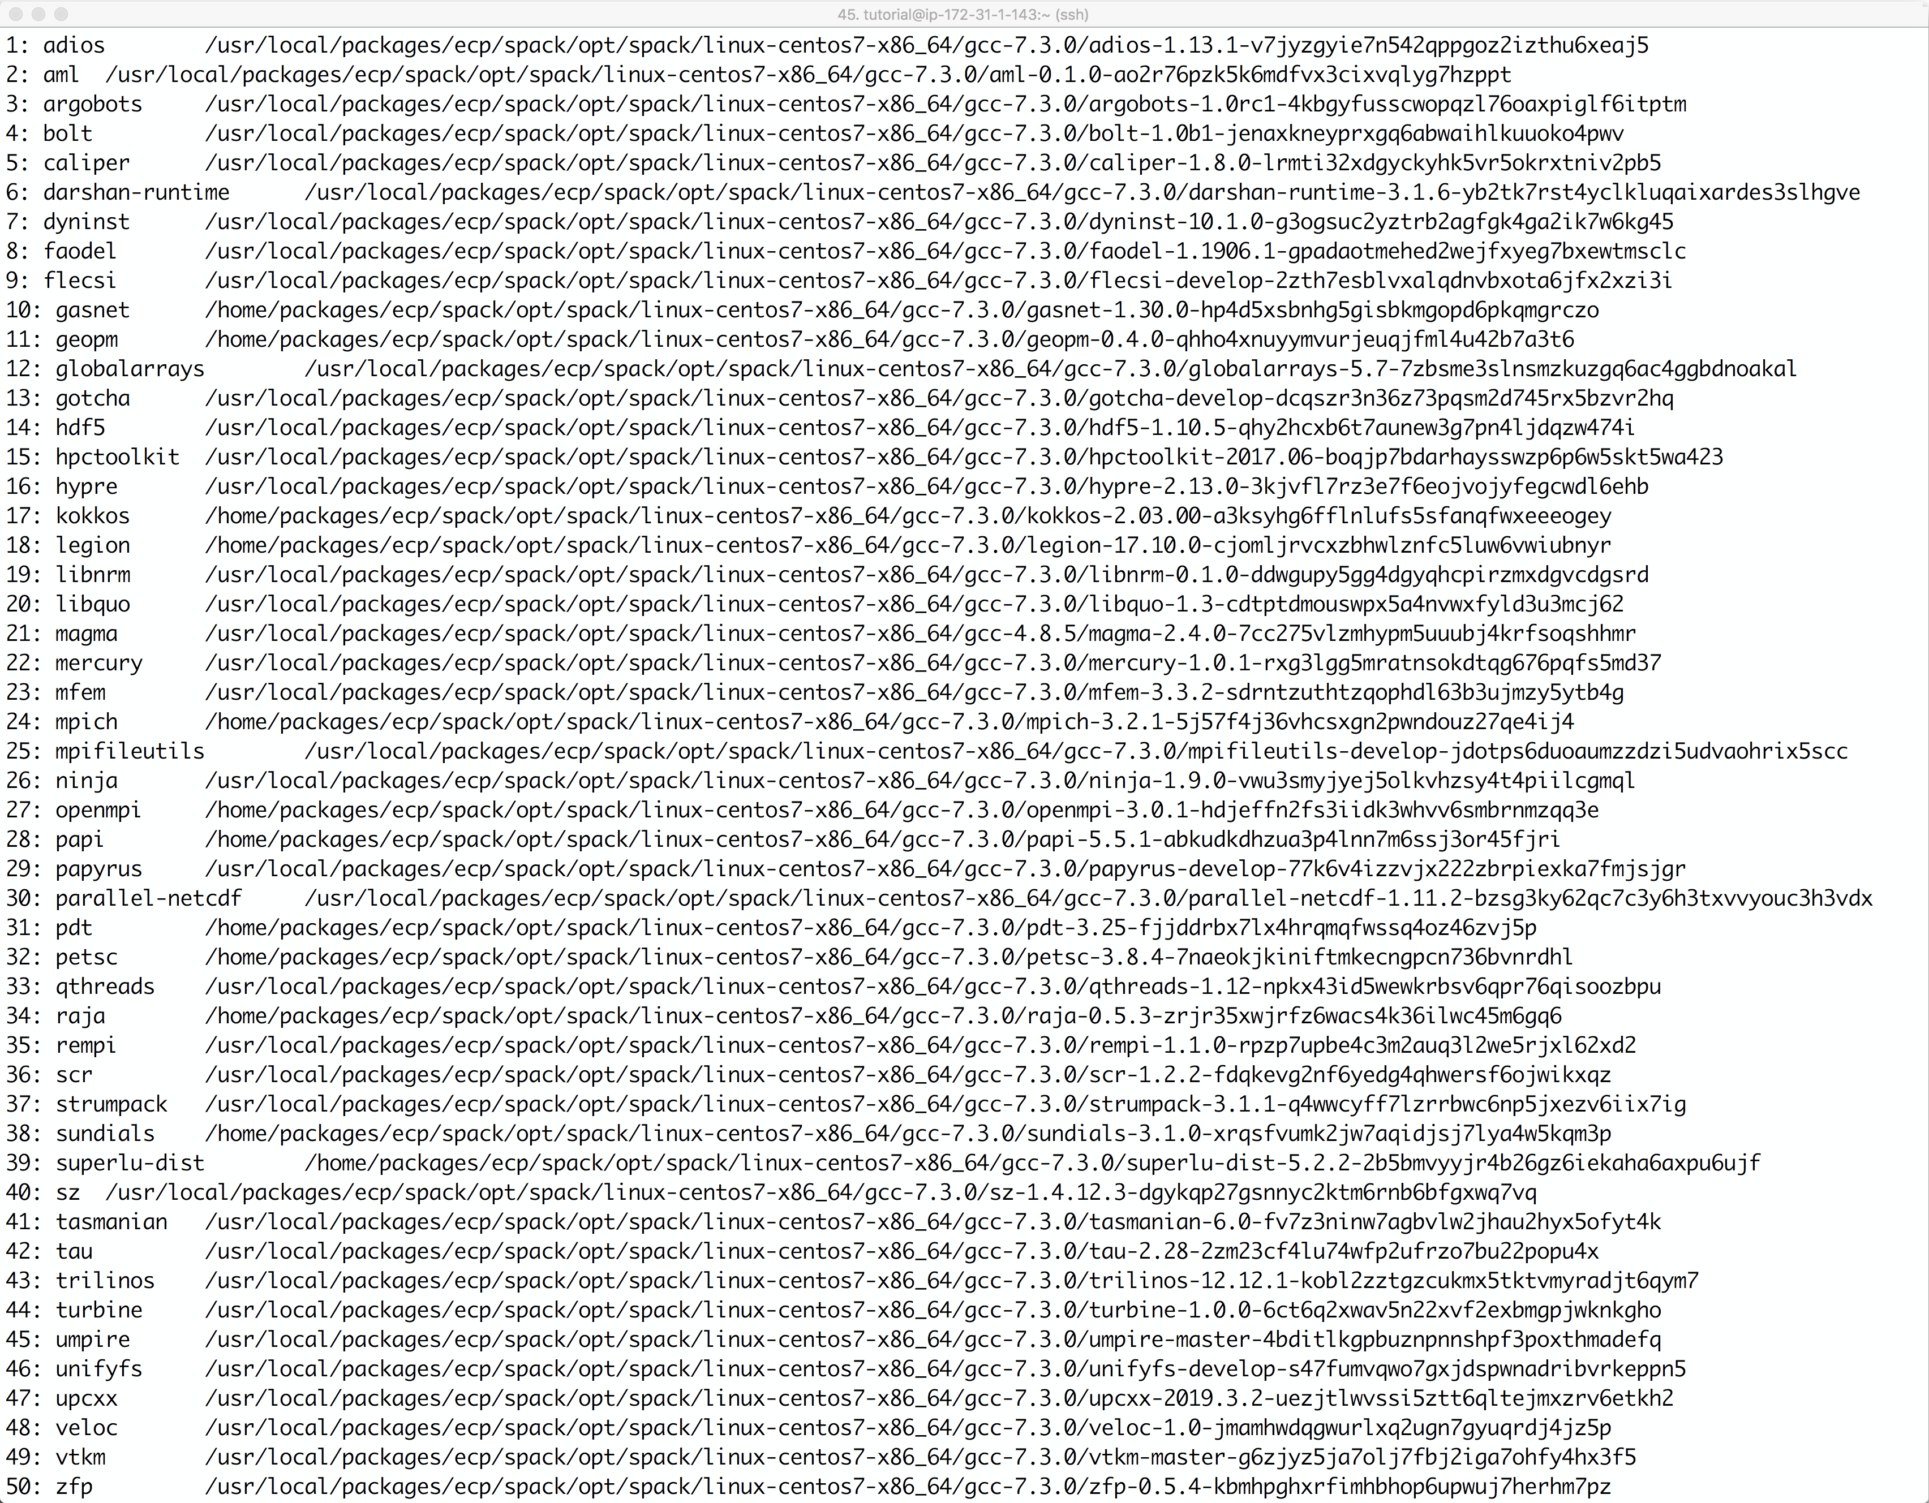
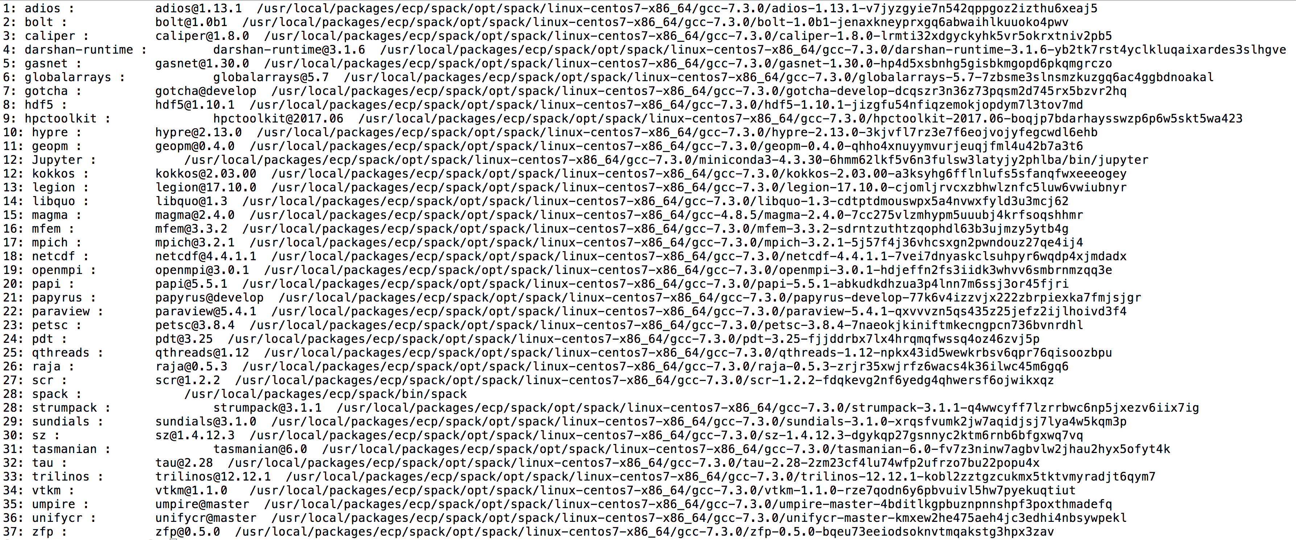
E4S v1.0 Release (50 Products):
exascaleproject/e4s_x86_64:1.0
on Dockerhub

Slide 30
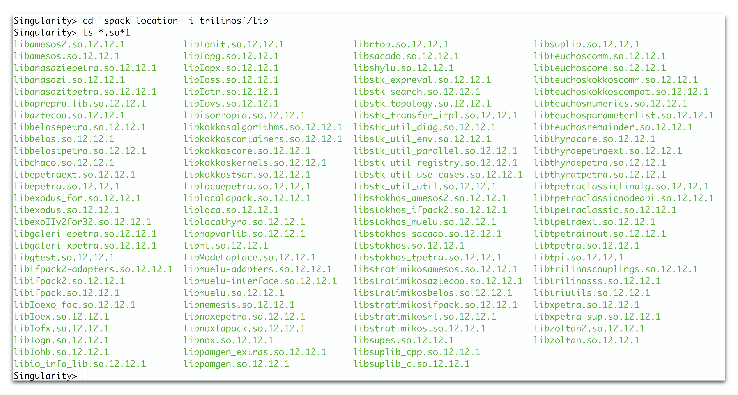
Extreme-scale Scientific Software Stack (E4S) https://e4s.io

Slide 31
Running MPI applications on other systems
Applications built with MPI in the E4S container can be replaced by the system MPI!
This allows fast inter-node communication using the native interconnect.
Application and data are external to the E4S container.
Programming models, compilers, runtime libraries, and tools are inside the container.
We can replace MPI using the MPICH ABI compatibility layer.
Goal: Build an MPI binary once and run it un-modified on all HPC Linux x86_64 clusters!

Slide 32
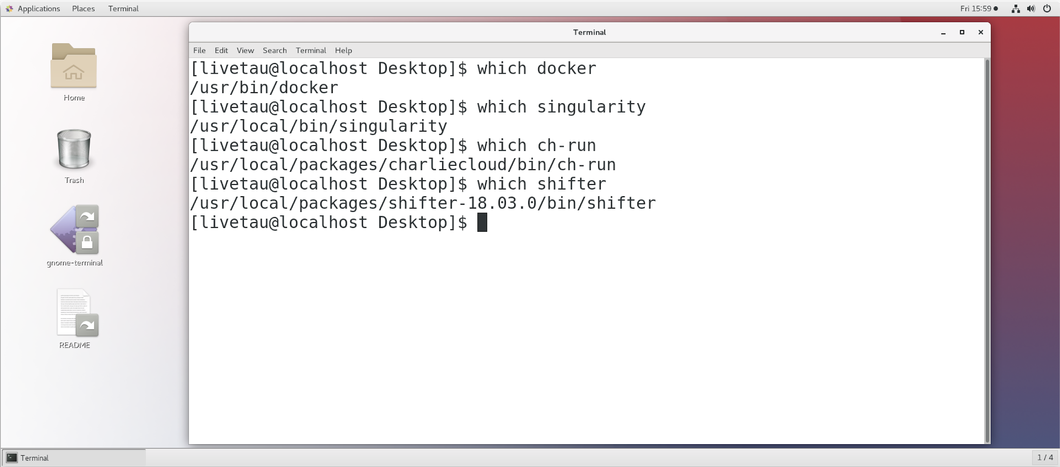
Using E4S on NCSA BlueWaters and replacing MPI
Step 1: Allocate a node with the E4S image
qsub -I -l nodes=2:ppn=32 -l walltime=01:15:00 -l gres=shifter16 -v UDI=exascaleproject/sdk:AHM19
This allocates a single node for 1:15h
Specifies the use of Shifter as the container environment
The image is exascaleproject/sdk:AHM19
This image was pulled on a compute node previously using:
%module load shifter; shifterimg pull exascaleproject/sdk:AHM19
After this qsub step, we can now launch the job using aprun

Slide 33
Using E4S on NCSA BlueWaters Replacing MPI
Step 2: Create a file called ~/shifter_mpi.sh
% cat ~/shifter_mpi.sh
#!/bin/bash
# set up LD_LIBRARY_PATH
for dir in $(echo $CRAY_LD_LIBRARY_PATH:/opt/cray/wlm_detect/default/lib64 | tr ':' ' ')
do
realpath=$(readlink -f "$dir")
if [[ -z $LD_LIBRARY_PATH ]]
then
eval 'export LD_LIBRARY_PATH=/dsl'$realpath
else
eval 'export LD_LIBRARY_PATH=$LD_LIBRARY_PATH:/dsl'$realpath
fi
done

Slide 34
Replacing MPI using cray-mpich-abi package
Step 3: Source this ~/shifter_mpi and setup LD_LIBRARY_PATH
% cat run.sh
#!/bin/bash
export CRAY_ROOTFS=SHIFTER
module load shifter
module unload PrgEnv-cray # or any other PrgEnv module currently loaded
module load PrgEnv-gnu # or PrgEnv-intel
module unload cce
module unload cray-mpich
module load cray-mpich-abi
export LD_LIBRARY_PATH=$CRAY_MPICH_DIR/lib:$LD_LIBRARY_PATH
source ~/shifter_mpi.sh
export LD_LIBRARY_PATH=/usr/local/packages/ecp/spack/opt/spack/linux-centos7-x86_64/gcc-7.3.0/hwloc-1.11.9-7xxgxbg65an7zmrztfcuu3hs73puj6v3/lib:$LD_LIBRARY_PATH
export OMP_NUM_THREADS=2
aprun -b -n 64 -- ./lulesh.host -i 100

Slide 35
Replacing MPI using cray-mpich-abi package
Step 4: run the example
% ./run.sh
Running problem size 30^3 per domain until completion
Num processors: 64
Num threads: 2
Total number of elements: 1728000
…
Run completed:
Problem size = 30
MPI tasks = 64
Iteration count = 100
Final Origin Energy = 8.465100e+07
Testing Plane 0 of Energy Array on rank 0:
MaxAbsDiff = 7.916242e-09
TotalAbsDiff = 3.030168e-08
MaxRelDiff = 1.224484e-13
Elapsed time = 16.58 (s)
Grind time (us/z/c) = 6.1409471 (per dom) (0.095952298 overall)
FOM = 10421.845 (z/s)
Elapsed time = 16.58 (s)
Grind time (us/z/c) = 6.0131382 (per dom) (0.22270882 overall)
FOM = 4490.1679 (z/s)
Application 81575093 resources: utime ~442s, stime ~20s, Rss ~45404, inblocks ~9110

Slide 36
Singularity on Theta at ALCF
% qsub -A ECP_SDK -t 30 -n 2 -q debug-cache-quad -I
% /projects/ECP_SDK/tutorial/run_job.sh
module swap PrgEnv-intel PrgEnv-gnu
module swap cray-mpich cray-mpich-abi
export SINGULARITYENV_LIBWLM_DETECT=/opt/cray/wlm_detect/1.3.2-6.0.6.0_3.8__g388ccd5.ari/lib64
aprun -n 16 -N 8 singularity exec -H $HOME -B /projects/ECP_SDK:/projects/ECP_SDK:ro -B /opt:/opt:ro -B /var/opt:/var/opt:ro /projects/ECP_SDK/containers/singularity/ecp.simg bash -c 'unset CRAYPE_VERSION; source /usr/local/packages/ecp/misc/bashrc; spack load trilinos hypre parmetis hdf5 metis openblas superlu zlib netcdf matio boost@1.66.0 scalapack suite-sparse tau ;spack unload openmpi mpich ; export LD_LIBRARY_PATH=$LIBWLM_DETECT:$CRAY_LD_LIBRARY_PATH:$CRAYPAT_LD_LIBRARY_PATH:$LD_LIBRARY_PATH ; /projects/ECP_SDK/tutorial/demo/trilinos/Zoltan/Zoltan; '

Slide 37
Singularity on Quartz at LLLNL
MVAPICH2 needs /lib. Mount it as /hostlib64 and add it to LD_LIBRARY_PATH
% salloc -N 2
% srun -n 4 -c 2 singularity exec -B /lib64:/hostlib64 -B $SLURM_SUBMIT_DIR:$SLURM_SUBMIT_DIR -B /usr/tce:/usr/tce ./ecp.simg /bin/bash -c ' . /etc/bashrc ; spack load trilinos hypre parmetis hdf5 metis openblas superlu zlib netcdf matio boost@1.66.0 scalapack suite-sparse tau; spack unload openmpi mpich; export LD_LIBRARY_PATH=/usr/tce/packages/mvapich2/mvapich2-2.2-intel-18.0.1/lib:$LD_LIBRARY_PATH:/hostlib64; ./Zoltan'

Slide 38
Replacing MPI with Shifter on Cori.nersc.gov
% shifterimg images
exascaleproject/sdk:AHM19 …
% To replace MPI with system MPI:
# salloc -N 2 -q interactive -t 00:30:00 --image=exascaleproject/sdk:AHM19 -C haswell -L SCRATCH
# ~sameer/run_shifter.sh
# cat ~/run_shifter.sh
srun –n 32 shifter -- /bin/bash -c 'unset CRAYPE_VERSION; . /etc/bashrc ; spack load trilinos hypre parmetis hdf5 metis openblas superlu zlib netcdf matio boost@1.66.0 scalapack suite-sparse tau; spack unload openmpi mpich; ./Zoltan'

Slide 39
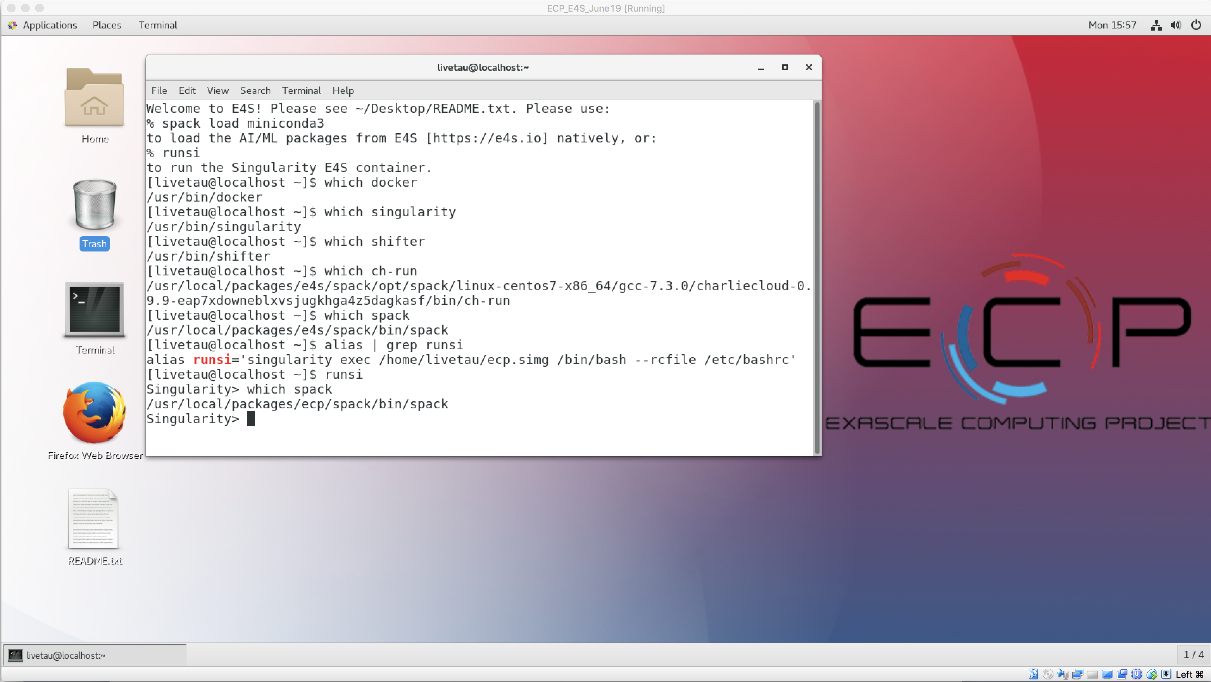
E4S VirtualBox OVA image
Contains all four container runtimes and the E4S Singularity image!
Docker
Singularity
Shifter
Charliecloud

Slide 40

E4S image on Amazon AWS
Contains all four container runtimes and the E4S Singularity image!
AWS AMI ID (Oregon, us-west-2 region):
ami-063e830287b86155c
Royalty free, public image with HPC, AI, and 4 container runtimes
Launch EC2 instance with this AMI
Login: livetau
Password: ****

Slide 41
Future work, issues…
Increasing the number of ST packages in E4S
Porting to IBM and ARM platforms
Support for GPUs and visualization tools
Addition of CI testing
Facility deployment
Scalable startup with full-featured “Supercontainers”
Improving the launch of MPI applications

Slide 42
E4S: How to get involved
E4S BoF at SC19
Tuesday, Nov. 19, 12:15pm – 1:15pm, Room 405-406-407
CANOPIE-HPC Workshop at SC19
1st Workshop on Containers and New Orchestration Paradigms for Isolated Environments in HPC
Monday, Nov. 18, 2019, 2pm – 5:30pm, Room 704-706
https://canopie-hpc.nersc.gov/

Slide 43

Acknowledgment
“This research was supported by the Exascale Computing Project (17-SC-20-SC), a collaborative effort of two U.S. Department of Energy organizations (Office of Science and the National Nuclear Security Administration) responsible for the planning and preparation of a capable exascale ecosystem, including software, applications, hardware, advanced system engineering, and early testbed platforms, in support of the nation’s exascale computing imperative.”

